Slide 1

Operating Systems 371-1-1631
Tutorial 12 – File System
Ben-Gurion University of the Negev Communication Systems Engineering Department

Slide 2
Motivation for using files
User needs
The address space of a process is limited
Some applications need memory which is far larger than their address space
E.g. airline reservations, banking, E-commerce

Slide 3
Files : Review
File: an abstraction that provides a way to store information on the disk.
File types:
User files (regular)
Directory files
Special files (I/O devices)
File access:
Sequential (byte after byte)
Random access

Slide 4
How to implement a file system?
Try 1: sequential allocation
Try 2: linked list
Notes:
Try 1’s cons: File’s size is unknown in advance. Files change size. Garbage collection.
Try 2’s cons: A rand’ access to file is extremely slow.

Slide 5
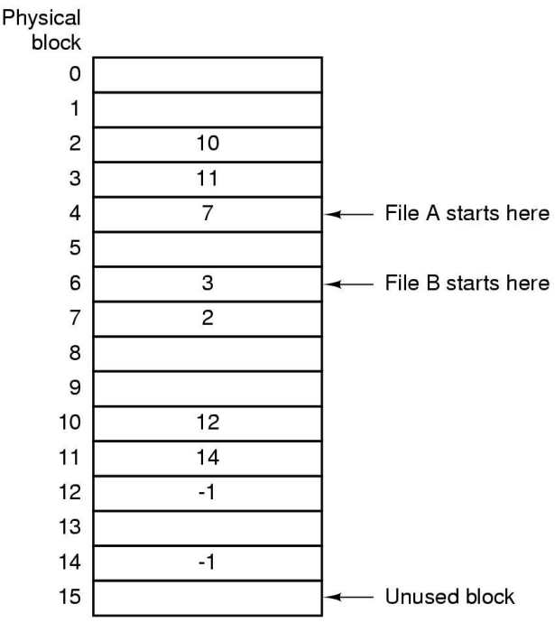
Try 3: File Allocation Table (FAT)

Slide 6
File Allocation Table (FAT)
The FAT contains chains of disk blocks
Every chain defines a different file
A FAT entry points to the next disk block of the file
I.e., specifies the block #
Chains of blocks are terminated by a special marker:
eof (end of file) character

Slide 7
File Allocation Table (FAT)
Used in MS-DOS
Still commonly used in portable / FLASH devices
The FAT is held in the main memory
Its size is proportional to the disk size / block size
What’s the risk of holding the FAT in the main memory?
Notes:
Answer:
In case of a sudden shutdown, its content (and file access as well) might be lost (remember, the RAM is volatile when no power is supplied to the system!)

Slide 8
MS-DOS Directory Entry
Fixed size 32-Byte directory entries
Directories provide information about the location of a file’s blocks (directly or indirectly)
Bytes | 8 | 3 | 1 | 10 | 2 | 2 | 2 | 4
 | File name | Ext. |  | Reserved |  |  |  | Size
read-only
hidden
system
archive
Time
Date
First block number - an index into the 64K entry FAT

Slide 9
FAT’s limitations
☹ Not scalable
Consider a 1-TB disk
Block size: 1 KB
What’s the FAT’s size?
☹ Not compatible to extensions / addition of attributes
Created, modified, accessed, owner, comments, …

Slide 10
I-Nodes (Index-node)
☺ Extended, scalable file’s attributes
Each I-node contains the file’s list of blocks
And, if needed – a pointer to additional disk blocks, containing lists of the next blocks
☺ Should be in the memory only when the file is open

Slide 11
I-Node example
Mode
Owners (2)
Time-Stamps (3)
File Size
Hard-Link Count to File
Direct Blocks (usually between 10-12)
Single Indirect
Double Indirect
Triple Indirect
Data
Data
Data
Data
Data
Data
Data
…
Data
Data
…
…
…
…
Data
Data

Slide 12
Question 1
How many disk accesses occur when a user executes:
> less /usr/tmp/a.txt
Assume:
Size of 'a.txt' is 1 block size.
The i-node of the root directory is not in memory.
Entries 'usr', 'tmp' and 'a.txt' are all located in the first block of their directories.

Slide 13
Question 1 – Solution
We need 3 directory accesses (‘/’, ‘usr’, ‘tmp’)
And 1 file access (‘a.txt’)
Each of the accesses above requires 2 disk accesses:
Reading the i-node.
Reading the first block of the file.

Slide 14
Question 2
The following system call
rename(char *old, char *new)
changes a file's name from 'old' to 'new'.
What’s the difference between this call, and just copying ‘old’ to a new file, ‘new’, followed by deleting 'old'? Answer in terms of disk access and allocation.

Slide 15
Question 2 – Solution
Rename
Merely changes a field in the i-node
Copy
Allocate a new i-node and blocks for the new file
copy the contents of the old file blocks to the new ones
Delete
Release the i-node and blocks of the old file

Slide 16
Question 3
Given is a node (file) with
direct, single indirect, double indirect, triple indirect entries.
Pointed by node.direct, node.single_direct and so on.
Given system calls:
read_block(block b)
free_block(block b)
free_i-node(i-node node)
Write a pseudo-code a system call which deletes the file and all its I-nodes

Slide 17
Question 5: reminder
Mode
Owners (2)
Time-Stamps (3)
File Size
Hard-Link Count to File
Direct Blocks (usually between 10-12)
Single Indirect
Double Indirect
Triple Indirect
Data
Data
Data
10KB
Data
Data
Data
Data
256
Entries
256KB
256KB
Data
Data
256
Entries
256
256
256
Data
Data

Slide 18
Question 3 – Solution
delete(i-node node){
for each block b in node.direct // remove the direct blocks
free_block(b);
for each block s in node.single_indirect {
single = read_block(node.single_indirect) // remove single indirect blocks
for each entry e in single
free_block(e);
free_block(single);
}
for each block d in node.double_indirect {
double = read_block(node.double_indirect) // remove double indirect blocks
for each entry s in double do {
single = read_block(d)
for each entry s in single do
free_block(s);
free_block(single);
free_block(double);
}
free_i-node(node); // remove the i-node
…
}

Slide 19
Question 4, part 1
Find the maximal file size in a 32-b OS, when:
The block size is 1KB
Pointer to a block requires 4B
An i-node contains
10 direct block entries
3 single-indirect entry
2 double-indirect entry
1 triple-indirect entry

Slide 20
Question 4, part 1 – Solution
Direct
10 blocks
Single indirect
3 * (1024/4) = 3*256 blocks
Double indirect
2 * 256^2 blocks
Triple indirect
1 * 256^3 blocks
Total
(10 + 3*256 + 2*256^2 + 256^3) KB

Slide 21
Question 4, part2
Repeat the question when the block size is 4KB
Direct
10 blocks
Single indirect
3 * (4K/4) = 3*K blocks
Double indirect
2 * M blocks
Triple indirect
1 * G blocks
Total
(10 + 3K + 2M + 1G) * 4KB > 4TB

Slide 22
Question 5
Given a 32-b OS with block size = 1KB
Each I-nodes has:
10 direct pointers
4 single-, double- and triple- indirect pointers
Each pointer takes 32-bits
Find the physical address of Byte # 1,515,000
Solution: see I-node.xlsx
Notes:
1,515,000 / 1024 =

Slide 23
Question 5: reminder
Mode
Owners (2)
Time-Stamps (3)
File Size
Hard-Link Count to File
Direct Blocks (usually between 10-12)
Single Indirect
Double Indirect
Triple Indirect
Data
Data
Data
10KB
Data
Data
Data
Data
256
Entries
256KB
256KB
Data
Data
256
Entries
256
256
256
Data
Data

Slide 24
Question 6
Consider the following FAT:
-1 indicates an eof; 0 indicates a free slot
The directory contains a file that points 7 as its starting block. How many blocks does that file contains?
Answer: 4 blocks
The file’s owner added 2 blocks to the file. Adjust the FAT according to the change.
Answer:
l
Index | 0 | 1 | 2 | 3 | 4 | 5 | 6 | 7 | 8 | 9 | 10
Pointers | 14 | 19 | 8 | -1 | -1 | -1 | 3 | 2 | 5 | 0 | 0
Index | 0 | 1 | 2 | 3 | 4 | 5 | 6 | 7 | 8 | 9 | 10
Pointers | 14 | 19 | 8 | -1 | -1 | 9 | 3 | 2 | 5 | 10 | -1

Slide 25
Question 7
ב-UNIX, המידע נשמר ב-i-node בארגון דמוי-עץ. מה הסיבה לכך שהעץ אינו עץ מלא?
הרצון למנוע את בזבוז הזמן והשטח הכרוך בשימוש בבלוקים בלתי ישירים עבור קבצים קטנים.
הרצון לנצל עד תום את השטח המוקצה ל-i-node (אין צורך להצביע על "גשרים" חסרי משמעות שנועדו לצורך השלמת רמות).
חוסר החשיבות של איזון העץ לאור כך שאין מדובר בחיפוש אחר איבר שרירותי (חיפוש מתבצע על תת-עץ כלשהו).

